Slide 1

What Signals an Economic Downturn?
By: Benjamin Aubry, Gary Fisher, and Bruce Mark

Slide 2
Every day, trillions of dollars are traded around the world by both humans and computers. The common goal between all parties involved is to make a profit on their respective trading strategies. When is the next market downturn?
Our Primary Question: What are potential economic and financial measurements that can be used to predetermine a downturn or recession in the US financial markets?
- Our team’s goal for this project is to each analyze a different securities’ data set in order to compare them to the S&P 500, then draw conclusions on whether the information reveals potential sell signals.

Slide 3
Can comparing yields between equities (stocks) and bonds predict a market downturn?
Why analyze these metrics? Equities (stocks) and bonds generally move in opposite directions from one another. By converting the equity prices to its yield equivalent, we can then directly compare equity yields to bond yields in order to find a trend.
Relevant Data Highlights:
Source: Quandl.com
Pricing Used: CME-S&P 500 spot month futures, US 10-Year Treasury Rate, and US 2-Year Treasury Rate

Slide 4
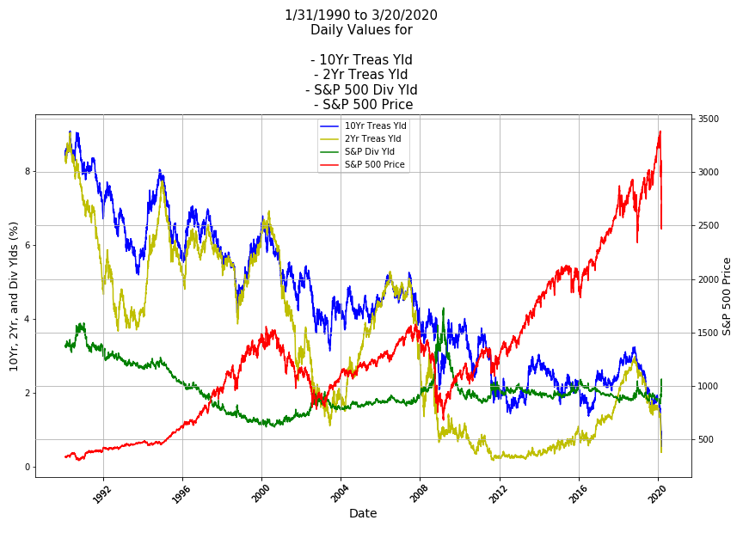

Slide 5
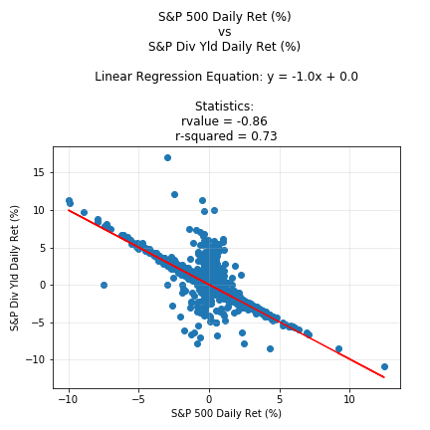
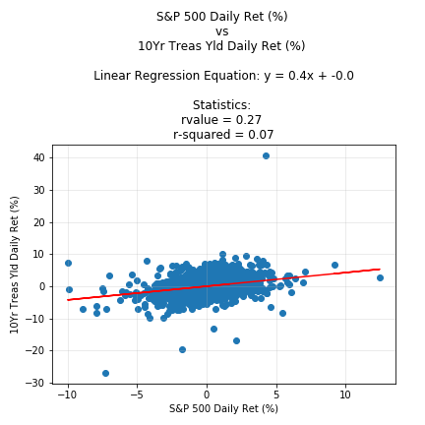
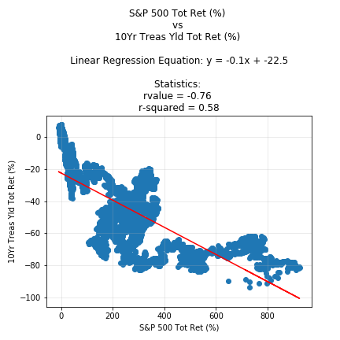
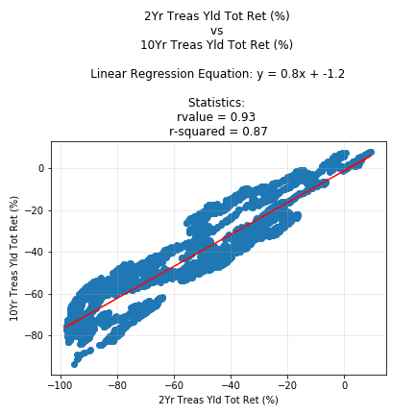

Slide 6
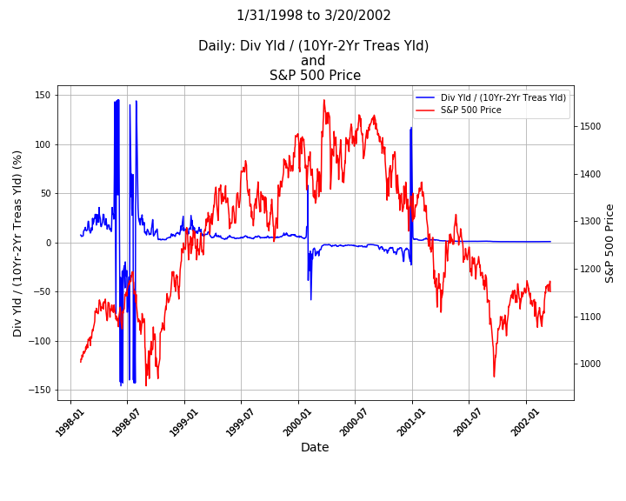
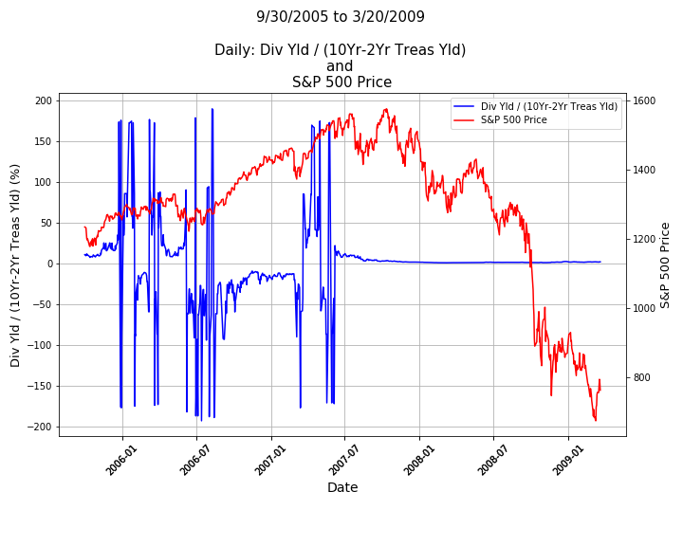

Slide 7
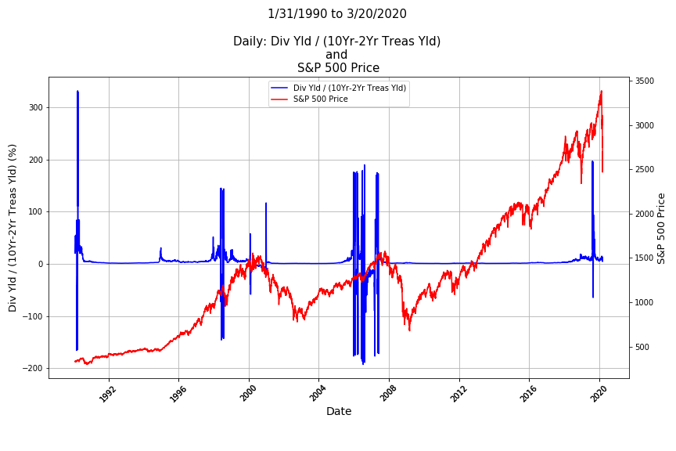

Slide 8
Conclusion:
The ratio previously compared to the S&P 500 does appear to be a leading indicator for trying to anticipate a large market downturn.
The most important part of the indicator seems to be when the ratio is above or below zero (0).
Only after the ratio changes from negative to positive will the “sell” signal be triggered.
Additional analysis will need to be performed on data before 1990 in order to compare results.

Slide 9
Can Corporate Debt Data be used to predict stock market routs ?
What are Corporate Credit Spreads and how are they measured:
Measured as the extra return an investor would make compared to a Treasury Bond (a Treasury bond is typically seen as a safe haven as it is debt issued and guaranteed by the government)
Corporates DO NOT borrow at the same levels as the government
The difference between the two borrowings (i.e. the interest rate difference) is the data we looked at !
Facts about the data used:
Source: Quandl.com (Financial database)
Pricing data:
B rated bonds index (The “B” is the rating given by rating agencies to borrowers – in this case we are looking at risky bonds)
Treasury Yields to derive the “spread” between the bonds and the benchmark (used the 5Y treasury for benchmarking).
S&P500 Index data
Analysis: Correlation between S&P500 & B-Rated Bond Index returns over time to generate buy/sell signals

Slide 10
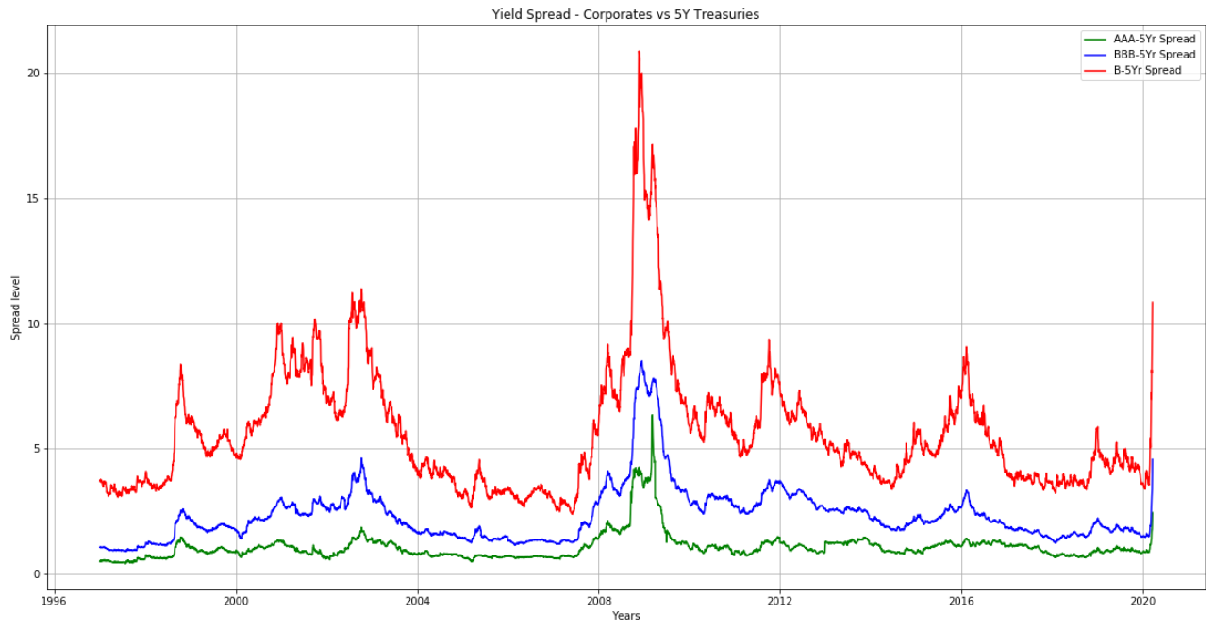
A Look at Spreads over time
Spreads tend to widen significantly during financial stress
This means that the cost of borrowing for these corporations is skyrocketing
Lenders / buyers of those bonds sell their holdings
Bankruptcy risk rises as a result as credit conditions deteriorate

Slide 11
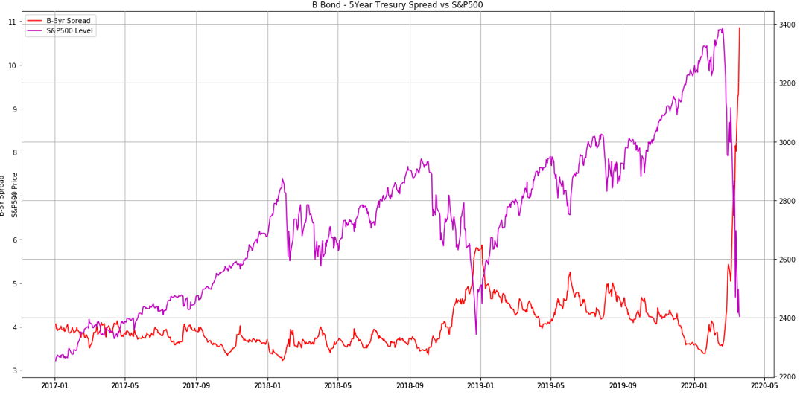
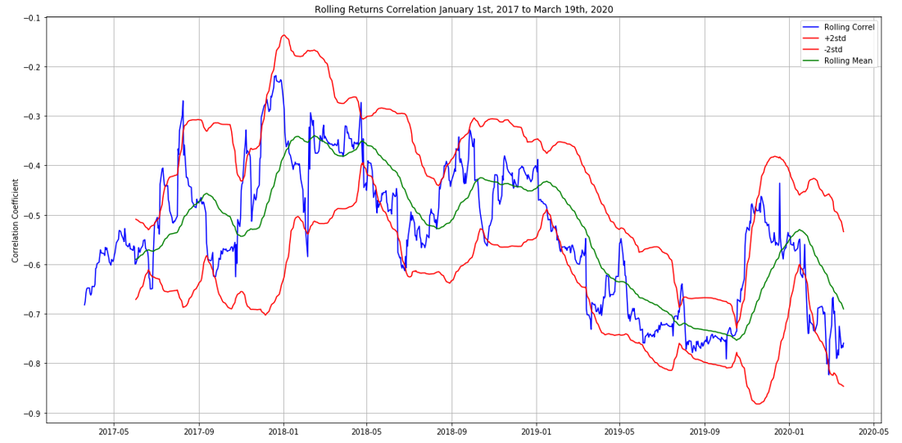
A closer look at the past 3 years…
The model seems to give reliable signals (buy/sell) in most cases.
The signal is given when the correlation hits +2/-2 standard deviations

Slide 12
Moving the research forward
While there seems to be some clear buy/sell signals on the S&P500 and this is a good starting point.
Some further analysis like the below could be conducted to use these signals in a production environment
Perform additional statistical testing specific to times series (in this case, we could test for mean reversion property)
Add filters to reduce the number of outliers – maybe adjust the signal with the standard deviation (Z-Score)
Add additional information from other markets (as we are only using spreads in this example) as this could lead to a trading model
Last but not least, we would need to run a full backtest (simulation of a trading strategy) and calculate the cumulative P&L of the strategy over time.

Slide 13
Copper / Gold Ratio: Can it predict a market downturn?
What is the Copper Gold Ratio? Price of copper / Price of gold
Why is it used? Copper is used mostly for industrial consumption and gold commonly as a store of value & in jewelry. Thus the price of copper tends to be more sensitive to business cycle pressures.
Relevant Data highlights:
Source: Quandl.com
Pricing used: CME-S&P 500 spot month futures, CME- Gold spot month futures, & CME-Copper spot month futures.
Settle prices for futures were used as well as daily change (“return”) of settle prices.
Correlation of Gold and Copper prices: +.88 The prices of these commodities typically behave similarly.

Slide 14
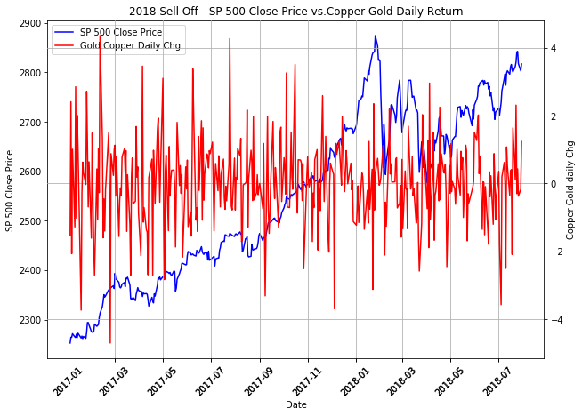
2018 S&P % : Peak to trough return = -19.8%
S&P had steep decline in 1st Quarter of 2018.
Daily % change of Copper Gold Ratio hit “high” highs (~4%) as the S&P climbed.
Daily % change of Copper Gold Ratio hit “lower” lows (~3.5%to 4%) prior to S&P declining.
Daily Change % of Copper Gold ratio appears to be predictive of S&P price directionality.
A false sell-off signal is shown in small pink circle.

Slide 15
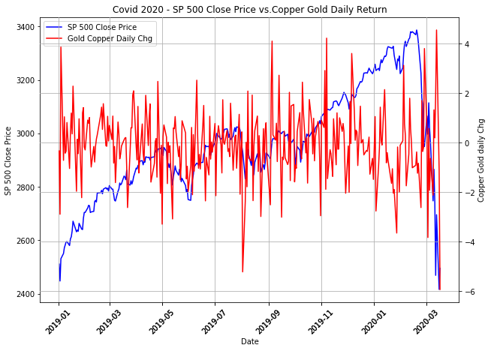
S&P % Peak to trough (this chart) return = -29%
Daily % change of Copper Gold Ratio hit “high” highs (~4%) in Sept, Nov, & Dec 2019 as the S&P climbed.
Daily % change of Copper Gold Ratio hit “lower” lows (3.5%to 4%) prior to S&P declining in 1st quarter 2020.

Slide 16
Copper Gold Ratio Conclusion
The Copper Gold Ratio appears to be a leading indicator of the S&P 500’s performance based on the analysis done here.
More analysis needs to be done to research the reasons for false positives that showed up in some of the charts.
More precise measures on the timing of the indicator relative to market performance are also needed.

Slide 17
Questions?

